Slide 1
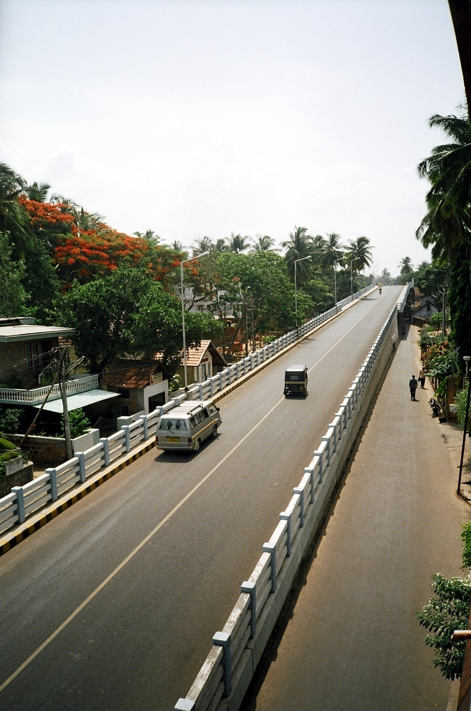
Roads And Bridges Development
Corporation of Kerala LTD
Road to Prosperity
Project Review Meeting –
1st June 2015

Slide 2
Progress review of ongoing projects
Up gradation of Airport Seaport to four lane - M/s EKK &Co
Flyover at Palarivattom NH66
(Old NH 47) Bypass - RDS Projects ltd
3. ROB at Aloor Mala - M/s CVCC
4. ROB at Angadipuram -M/s CVCC
5. Airport Seaport Road-Phase II-
Two River Bridges - M/s CVCC
6. ROB at Kumaranelloor - Shri. K.N.Madhusudhanan
7. ROB at Kunjippalli - M/s Skilled Constructions
ROB at Eroor - M/s Skilled Constructions
Adjacent span- Divine Nagar - M/s Unique Enginering

Slide 3
UP GRADATION OF AIRPORT SEAPORT ROAD TO FOUR LANE -PHASE I

Slide 4
UP GRADATION OF AIRPORT SEAPORT ROAD TO FOUR LANE -PHASE I – PROGRESS REPORT AS ON 30.05.2015
Upgrdadation of airport seaport road to four lane phase -1 from 8+900 to 11+350
Monthly Report
Work progress for the Month of May- 15
Sl. No. | BOQ no | Item Description | Unit | Total | Up to date | Percentage
 |  |  |  | Quantity | Quantity
1 | 1.01 | Clearing and grubbing road land | HA | 3.9 | 2.891 | 74%
2 | 1.09 | Excavation for roadway | Cum | 1320 | 1011 | 77%
3 | 1.10 | Earthwork excavation at embankment foundation | Cum | 30210 | 20218 | 67%
4 | 1.11 | Loosening, leveling and Compacting | Cum | 1240 | 2802 | 226%
5 | 1.12 | Construction of sub-grade and earthen shoulders | Cum | 5290 | 0 | 0%
6 | 1.13 | GSB (Grade I) | Cum | 8050 | 5517 | 69%
7 | 1.14 | Wet Mix Macadam (WMM) | Cum | 6900 | 4275 | 62%
8 | 1.15 | Primer coat (0.75KG/Sqm) | Sqm | 24370 | 16866 | 69%
9 | 1.16 | Tack coat | Sqm | 50230 | 122114 | 243%
10 | 1.17 | BM | Cum | 500 | 1354 | 271%
11 | 1.18 | DBM | Cum | 5790 | 4167 | 72%
12 | 1.19 | BC | Cum | 1860 | 1780 | 96%
13 | 1.20 | Kerb stone | Rm | 8800 | 4274 | 49%

Slide 5
UP GRADATION OF AIRPORT SEAPORT ROAD TO FOUR LANE -PHASE I – PROGRESS REPORT AS ON 30.05.2015
Sl. No. | BOQ no | Item Description | Unit | Total | Up to date | Percentage
 |  |  |  | Quantity | Quantity
14 | 1.27 | Construction of embankment (road way cutting material) | Cum | 3890 | 3467 | 89%
15 | 1.28 | PCC M15 for sub-structure - for culverts , drain, utility duct etc | Cum | 1050 | 766 | 73%
16 | 1.29 | PCC M25 for sub-structure/super structure etc for culverts , drain, utility duct | Cum | 5070 | 2193 | 43%
17 | 1.30 | HYSD bar reinforecemnt in sub -structure | MT | 510 | 183 | 36%
 | 1.31 | Painting two coats of Enamal paint | Sqm | 5870 | 355 | 6%
 | 1.32 | Providing and layiong of hot applied thermoplastic paint | Sqm | 1860 | 1903 | 102%
 | 1.33 | Supply and installation of delineators | Nos | 44 | 79 | 180%
 | 1.34 | Providing and fixing of road studs | Nos | 7500 | 1800 | 24%
 | 1.35 | Providing and fixing of red reflectors | Nos | 2200 | 843 | 38%
18 | 1.36 | M20 grade concrete guard posts 200 x 200 mm x1.25 m | Nos | 550 | 57 | 10%
19 | 1.37 | Cautionery , mandatory and informatory sign
20 | a | Triangular 900mm size | Nos | 51 | 51 | 100%
21 | b | Circular 600mm size | Nos | 6 | 20 | 333%
22 | c | Informatory/ Mandatory signs 800mm x600mm | Nos | 26 | 0 | 0%

Slide 6
Sl. No. | BOQ no | Item Description | Unit | Total | Up to date | Percentage
 |  |  |  | Quantity | Quantity
23 | d | 900mm high octagon | Nos | 4 | 1 | 25%
24 | 1.38 | Place identification retro-reflectorised sign
25 | a | OHM for culverts, openings etc | Sqm | 3.6 | 5.6 | 156%
26 | b | Chevron signs 600mmx 600mm | Sqm | 6.6 | 6.4 | 97%
27 | c | Chevron signs 1200mmx 600mm | Sqm | 4.4 | 0 | 0%
28 | 1.43 | Tree planting | Nos | 350 | 180 | 51%

Slide 7
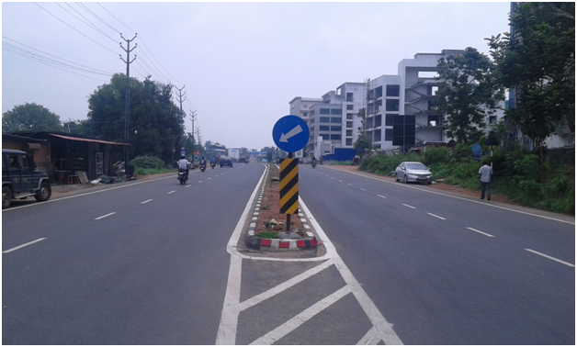
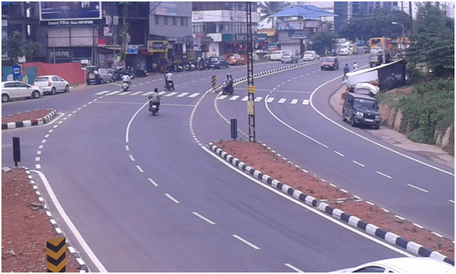
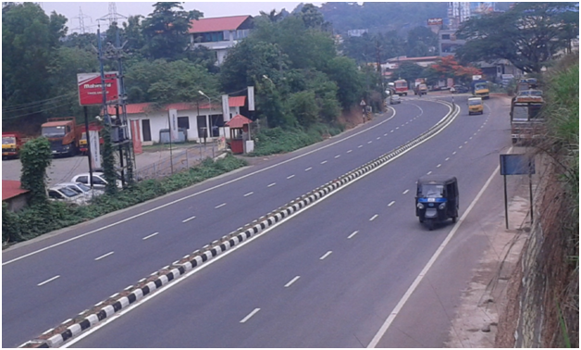
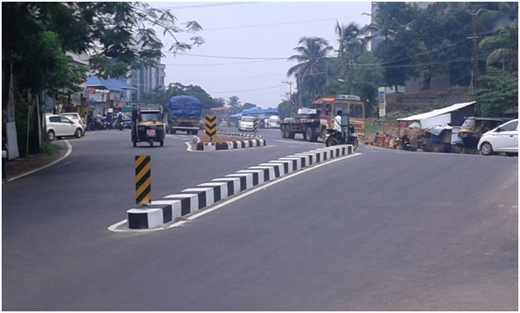
UP GRADATION OF AIRPORT SEAPORT ROAD TO FOUR LANE - PHASE I PROGRESS PHOTOS – 30.05.2015
Ch 8+960
Ch 9+500
Ch 9+800
Vallathole Jn.

Slide 8
Flyover at Palarivattom in NH 66 (OLD 47) BYPASS

Slide 9
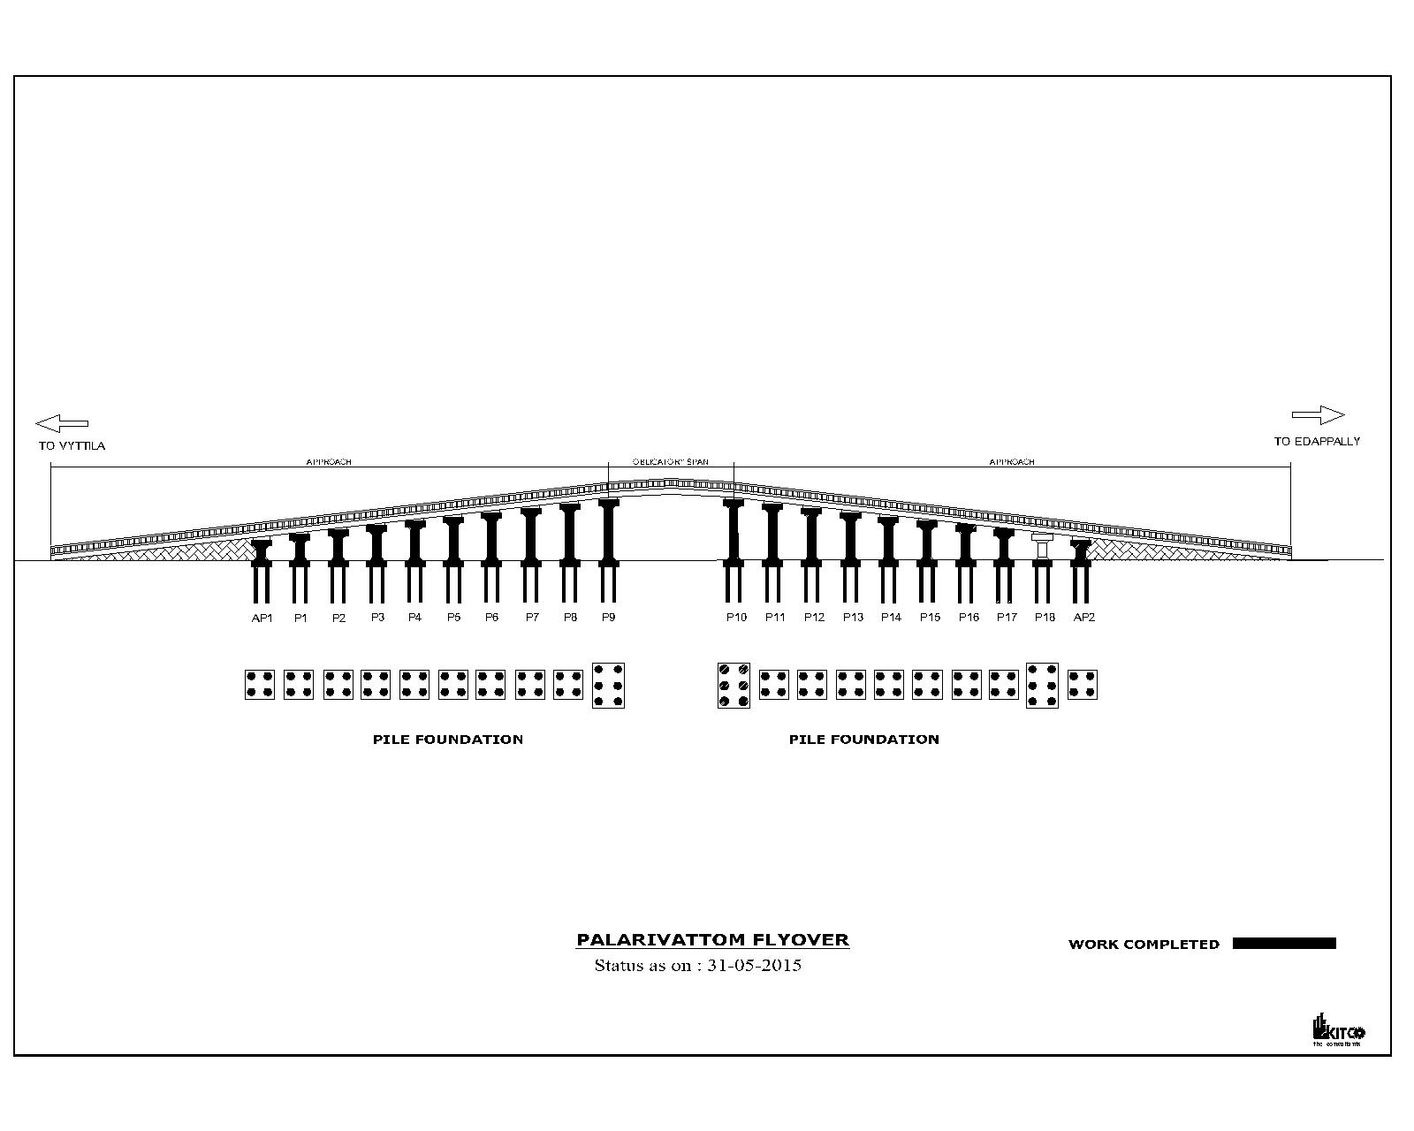
Flyover at Palarivattom in NH 66 (OLD 47) BYPASS
Progress Graph-30.05.2015

Slide 10
Flyover at Palarivattom in NH 66 (OLD 47) BYPASS
Progress Report-30.05.2015
Si No | Activity Description | Total Quantity | Cumulative progress upto 31.05.15 | Balance work up to 31.05.15 | Actual work done during this Month | Work planned for next week | Remarks
1 | PILE Edappally side | 44 | 44 | 0 | 0 | 0 | P10-1,2,3,4,5,6/P11-1,2,3,4/P12-1,2,3,4/P13-1,2,3,4/P14-1,2,3,4/P15-1,2,3,4/P16-1,2,3,4/P17-1,2,3,4/P18-1,2,3,4,5,6/AP2-1,2,3,4
2 | PILE vytilla side | 42 | 42 | 0 | 0 | 0 | AP1-1,3,4,2/ P1-1,2,3,4 / P2-4,2,3,1 / P3-1,2,3,4 / P4-1,2,3,4 /P5-1,2,4,3/P6-1,2,3,4/ P7-1,2,3,4/P8-1,2,3,4/ P9-1,2,3,4,5,6
5 | PILE CAP Edappally side | 10 | 10 | 0 | 1 | 0 | P10,P11,P12,P13,P14,P15,P16,P17,AP2,P18
7 | PILE CAP vytilla side | 10 | 10 | 0 | 0 | 0 | AP1,P1,P2,P3,P4,P5,P6,P7,P8,P9
9 | PIER Edappally side | 10 | 10 | 0 | 1 | 0 | P10,P11,P12,P13,P14,P15,P16,P17,AP2
11 | PIER Vytilla side | 10 | 10 | 0 | 0 | 0 | AP1, P1, P2, P3, P4, P5, P6,P7,P8,P9
12 | PIER CAP Edappally side | 10 | 9 | 1 | 0 | 1 | P10,P11,P12,P13,P14,P15,P16,P17,AP2

Slide 11
Flyover at Palarivattom in NH 66 (OLD 47) BYPASS
Progress Report-30.05.2015
Si No | Activity Description | Total Quantity | Cumulative progress upto 31.05.15 | Balance work up to 31.05.15 | Actual work done during this Month | Work planned for next week | Remarks
13 | PIER CAP Vytilla side | 10 | 10 | 0 | 0 | 1 | AP1,P1,P2,P3,P4,P5,P6,P7, P8,P9
14 | GIRDER EDAPPALLY side | 58 | 29 | 29 | 13 | 12 | G1,G2,G3,G4,G5,G6,G15,G17,G18,G19,G21,G23,G24,G26, G28,G29,G30,G31,G33,G34, G37,G38,G39,G42,G43,G44,G46,G48,G49
15 | GIRDER vytila side | 54 | 21 | 33 | 8 | 10 | G7,G8,G9,G10,G11,G12, G13,G14,G16,G20,G22,G25, G27,G32,G35,G36,G40,G41, G45,G47
16 | GIRDER obligatory span | 10 | 0 | 10 | 0 | 0
17 | service road edply west | 100% | 90% | 10% | 0% | Up to BC | DBM completed
18 | service road edply east | 100% | 90% | 10% | 0% | Up to BC | DBM completed
19 | service road vytila west | 100% | 90% | 10% | 0% | Up to BC | DBM completed
20 | service road vytila east | 100% | 90% | 10% | 0% | Up to BC | DBM completed
21 | Girder Launching Edappally side | 58 | 0 | 58 | 0 | 8
22 | Girder Launching Vytila side | 54 | 2 | 52 | 0 | 8

Slide 12
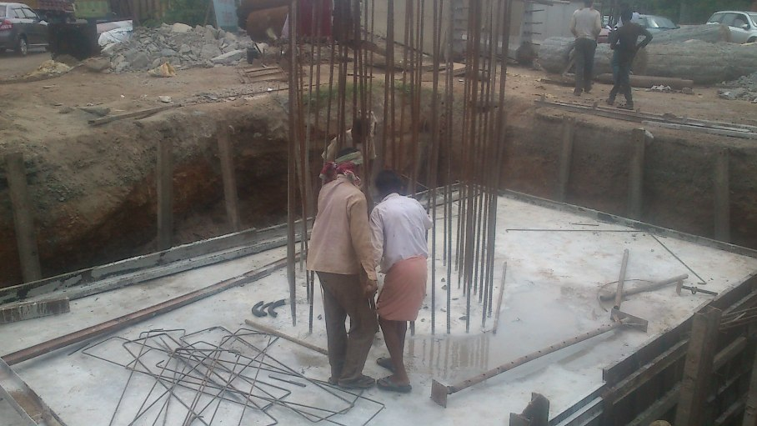
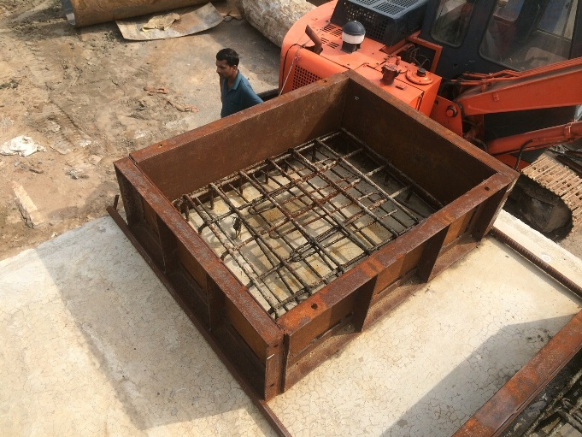
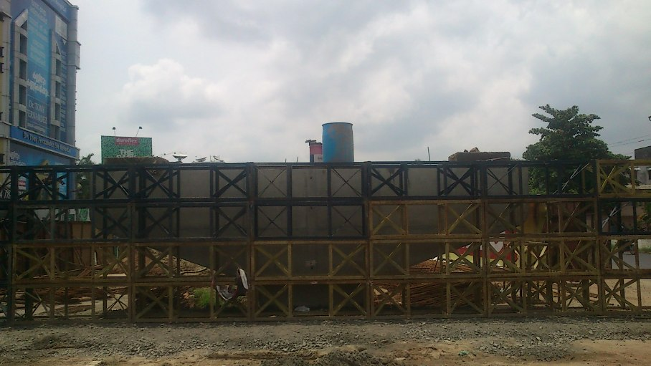
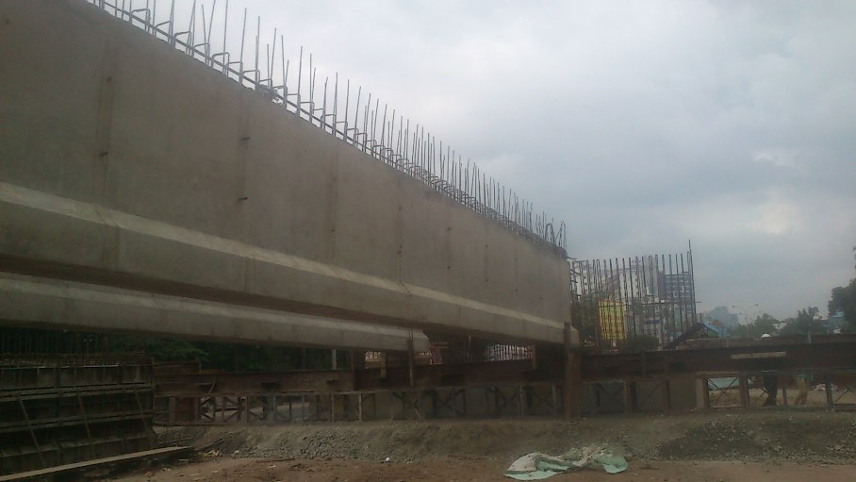
Flyover at Palarivattom in NH 66 (OLD 47) BYPASS
Progress Photos- 30.05.2015
P18 Pile Cap
P16 Pedestal
Crib Support for girder
Girders lifted A1-P1

Slide 13
ROB AT ALOOR – MALA

Slide 14
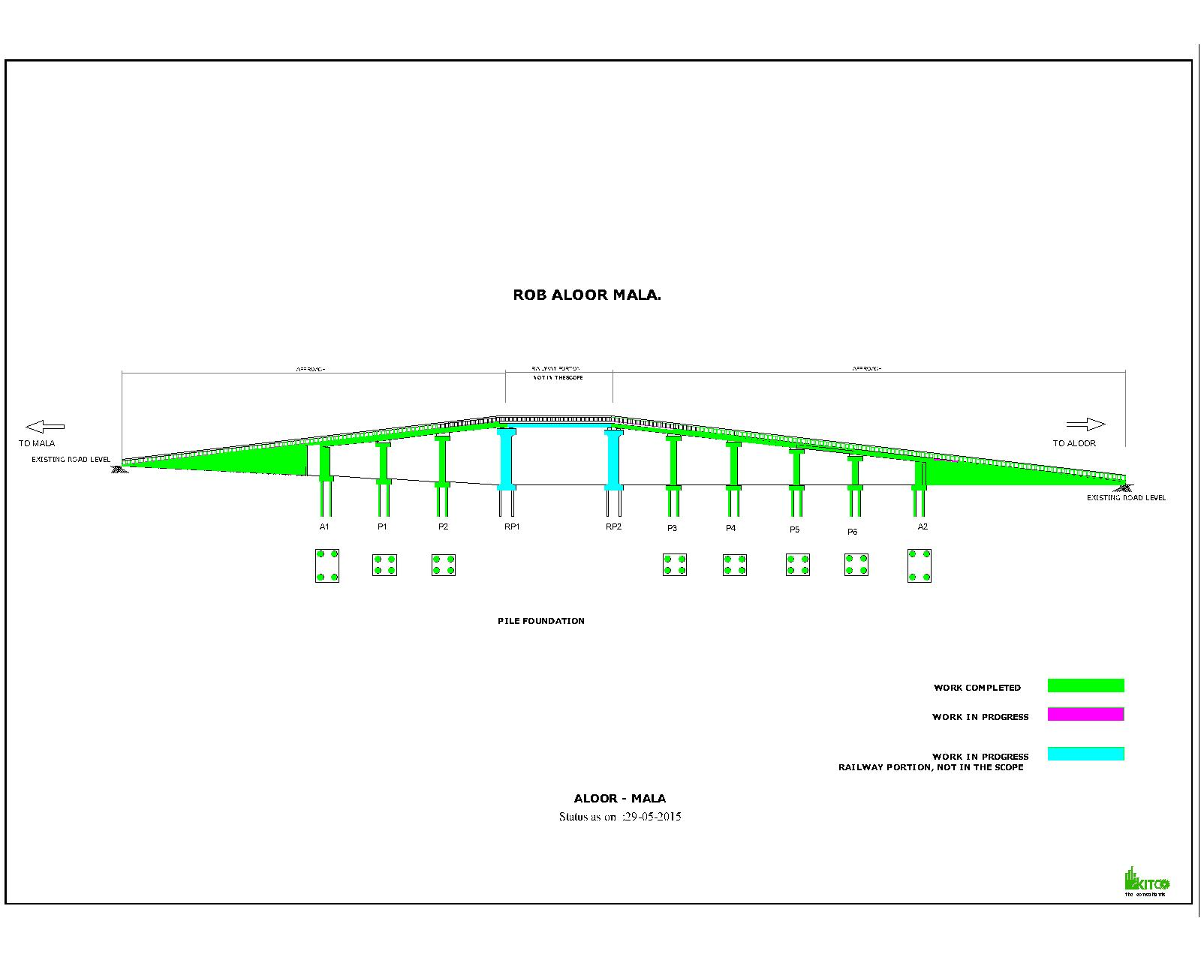
ROB AT ALOOR – MALA
PROGRESS GRAPH- 30.05.2015

Slide 15
ROB AT ALOOR – MALA
PROGRESS REPORT-30.05.2015
Sl No | Activity Description | Total Quantity | Cumulative progress upto May 2015 | Balance work up to May 2015 | Cumulative delay in days from Baseline | Work planned for May 2015 | Actual work done- May 2015 | Delay in Qty in May 2015 | Remarks
1 | Pile | 32 | 32 | 0
2 | Pile Load Test | 1 | 1 | 0
3 | Pilecap | 8 | 8 | 0
4 | Pier | 8 | 8 | 0
5 | Piercap | 6 | 6 | 0
6 | Girders | 8 | 8 | 0
7 | Deckslab | 8 | 7 | 1
8 | Handrails ,KERB & footpath slab casting | 8 | 8 | 0
9 | Retaining Wall | 100% | 100% | 0%
10 | Diversion Road works | 100% | 100% | 0%
11 | Adjacent span-Girder
12 | Adjacent span- Slab

Slide 16
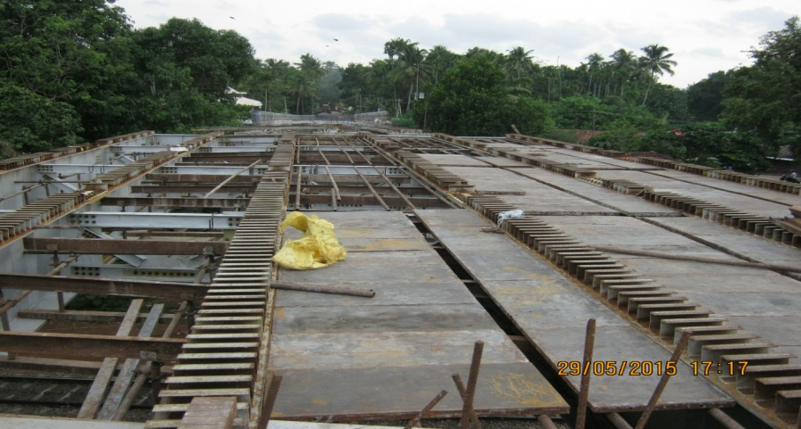
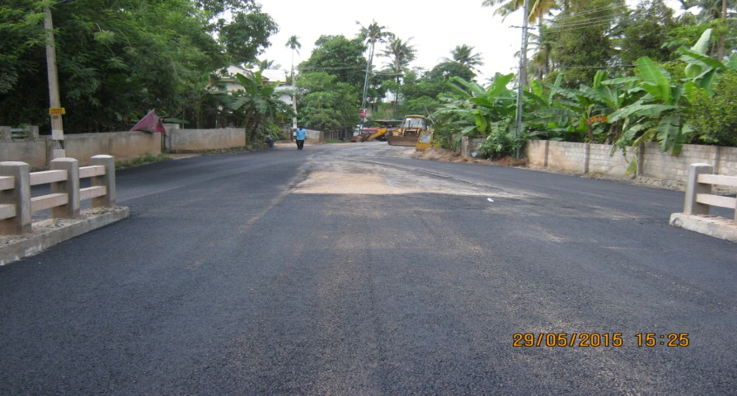
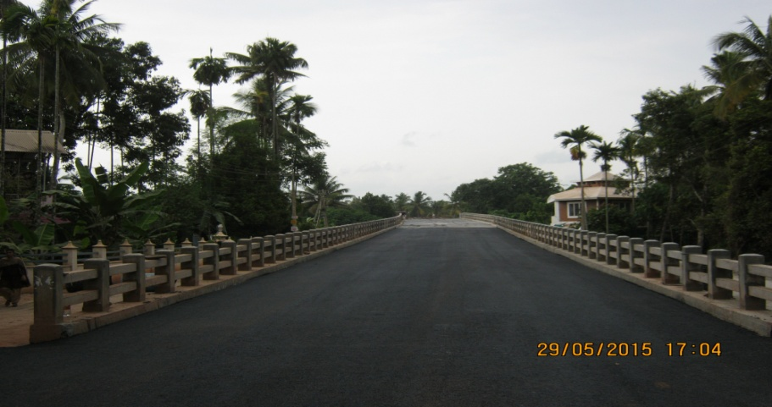
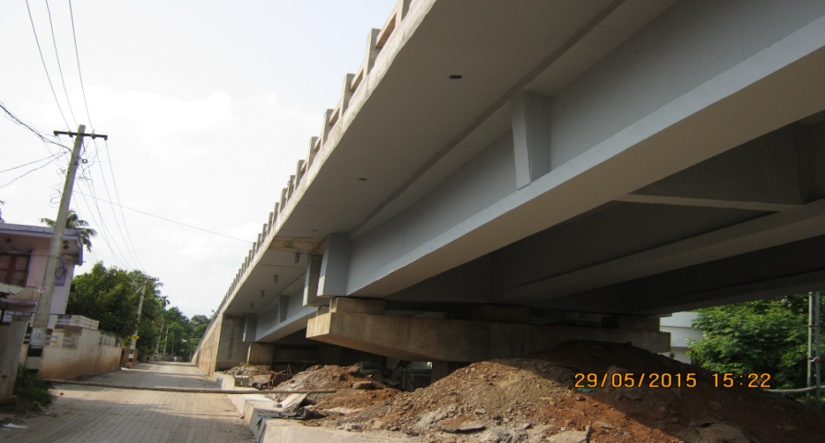
ROB AT ALOOR – MALA
PROGRESS PHOTOS- 30.05.2015
Railway Span work
ROB View from Aloor side
ROB View from Mala Side
Painting works in progress

Slide 17
ROB AT ANGADIPURAM

Slide 18
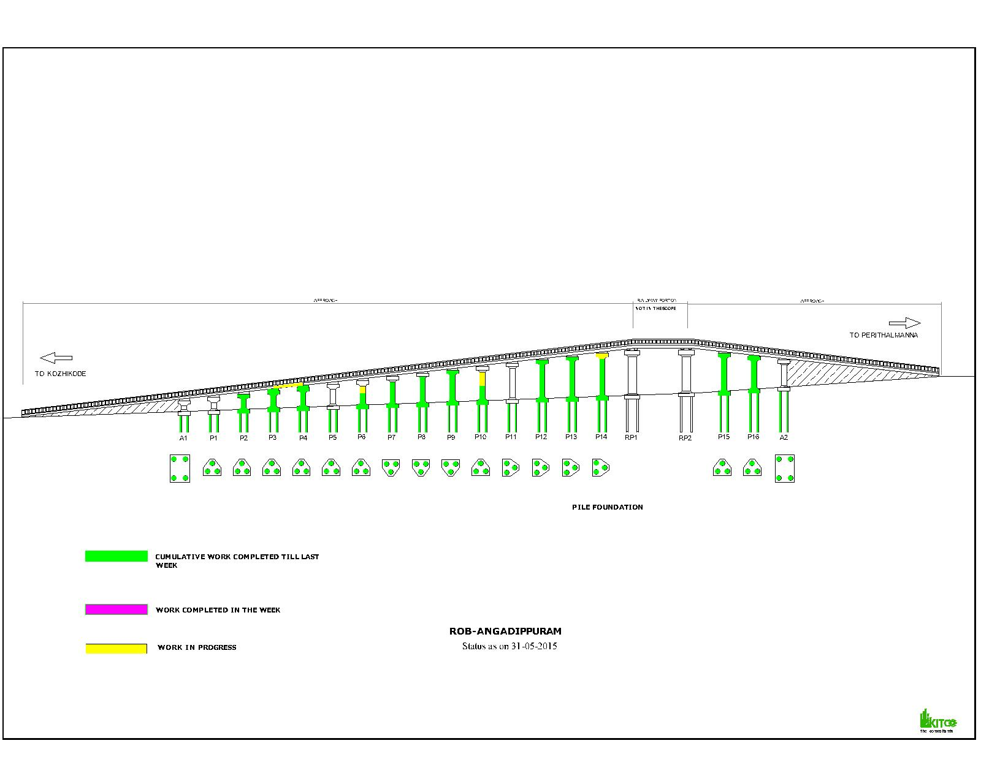
ROB AT ANGADIPURAM
PROGRESS GRAPH- 30.05.2015

Slide 19
ROB AT ANGADIPURAM
PROGRESS REPORT-30.05.2015
Sl No | Activity Description | Total Quantity | Cumulative progress up to May 2015 | Balance work up to May 2015 | Work planned for May 2015 | Actual work done during May 2015
1 | Pile | 56 | 56 | 0 | 0 | 0
2 | Pilecap | 18 | 13 | 5 | 0 | 0
3 | Pier | 18 | 11 | 7 | 2 | 0
4 | Pier cap | 16 | 8 | 8 | 2 | 1
7 | Girders | 54 | 0 | 54 | 1 | 0
8 | Deckslab | 18 | 0 | 18 | 1 | 0

Slide 20
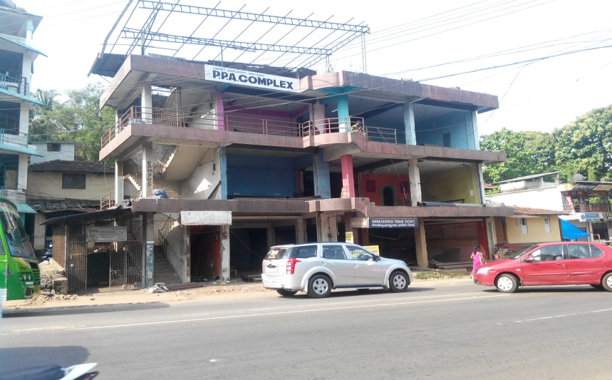
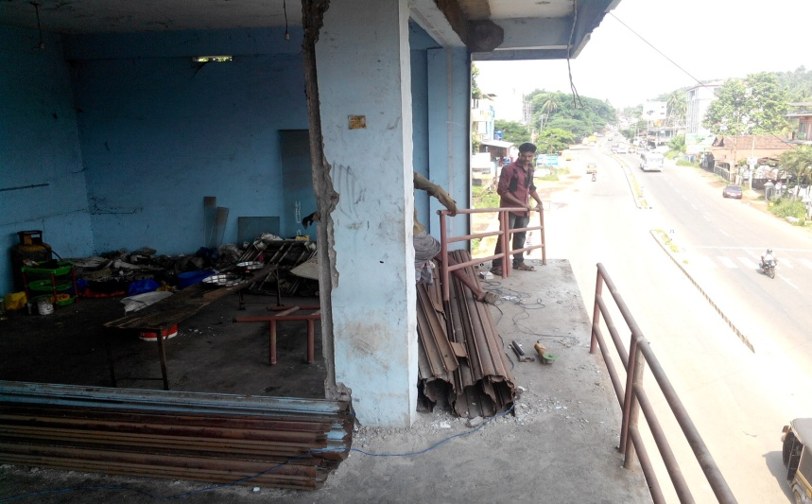
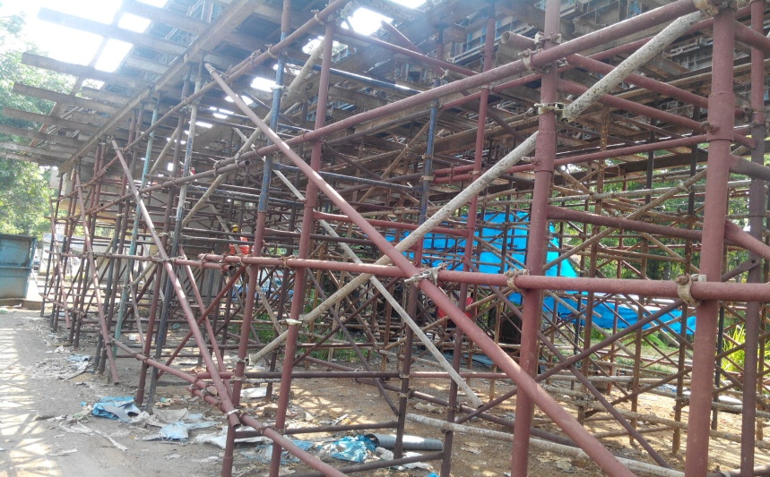
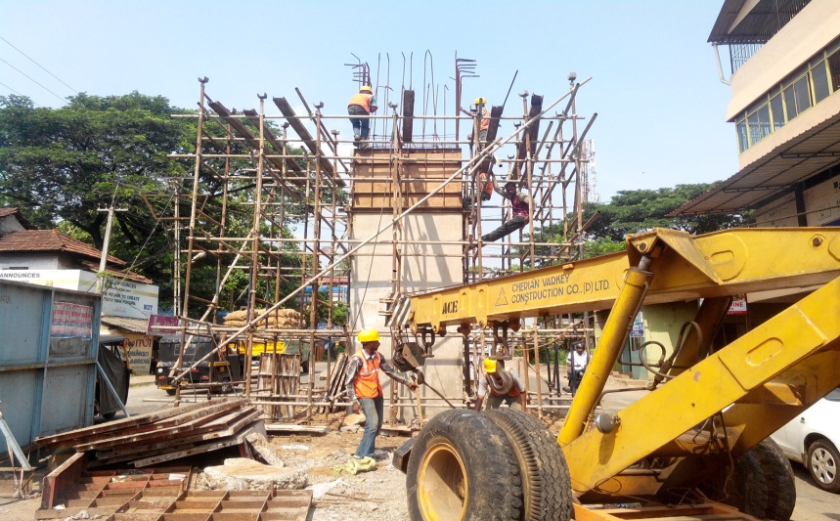
ROB AT ANGADIPURAM
PROGRESS PHOTOS – 30.05.2015
Dismantling of Existing Buildings
Girder work at span P3-P4
Shuttering works for P 14 Pier cap

Slide 21
Airport Seaport Road Phase II to Construction of Two River Bridges across Periyar-

Slide 22
Airport Seaport Road Phase II to Construction of Two River Bridges across Periyar- Progress Graph -30.05.2015

Slide 23
5.ONGOING PROJECT-PROGRESS REPORT
Airport Seaport Road Airport Seaport Road Phase II to Construction of Two River Bridges across Periyar- 30.05.2015
Airport Seaport Road Phase II to Construction of Two River Bridges
Airport Seaport Road Phase II to Construction of Two River Bridges across Periyar- Progress Report -30.05.2015
Sl No | Activity Description | Total Quantity | Cumulative progress upto May 15 | Balance work up to May 15 | Cumulative delay in days from Baseline | Work planned for May 15 | Actual work done-May 15 | Delay in Qty in May 15 | Remarks
1 | Pile | 73 | 69 | 4
2 | Pile Load Test | 3 | 2 | 1
3 | Pilecap | 18 | 17 | 1
4 | Pier | 18 | 17 | 1
5 | Piercap | 18 | 17 | 1
6 | Dirt wall | 4 | 2 | 2
6 | Girders ( Main Bridge) | 48 | 38 | 10
7 | Girders ( Main Bridge) launching | 48 | 32 | 16
7 | Deckslab | 12 | 5 | 7
8 | Handrails & footpath slab casting | 100% | 0% | 100%
9 | Retaining Wall Aluva side | 100% | 0% | 100%
10 | Retaining Wall Thuruthu side | 100% | 0% | 100%
11 | Road work Aluva side | 100% | 0% | 100%
12 | Road work Thuruthu side | 100% | 60% | 40%
13 | Girders ( Minor bridge) | 16 | 9 | 7

Slide 24
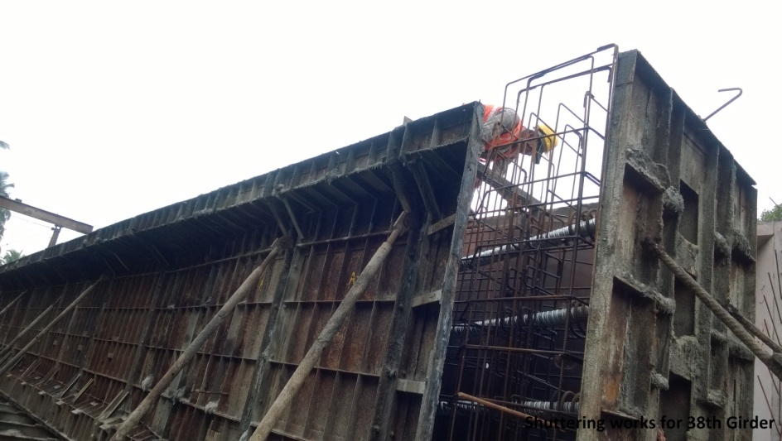
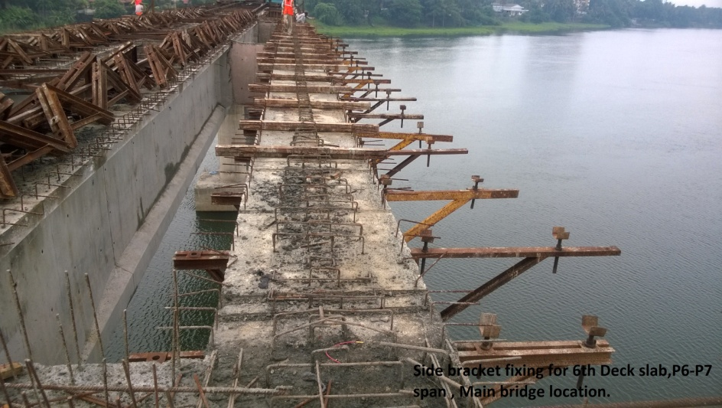
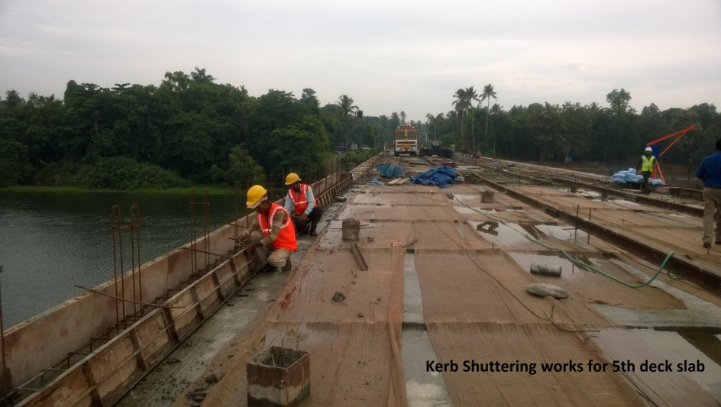
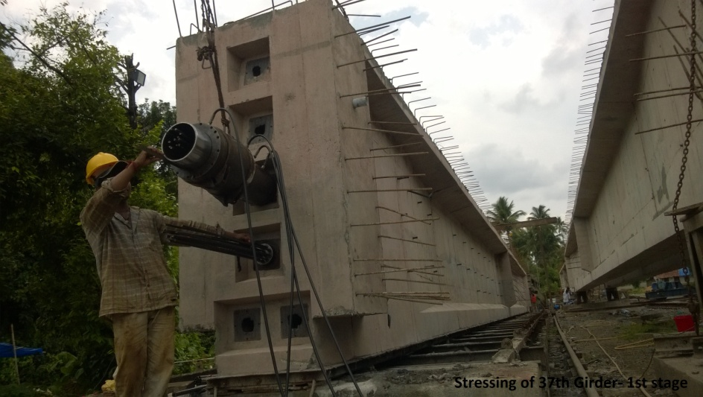
Airport Seaport Road Phase II to Construction of Two River Bridges across Periyar- Progress Photos-30.05.2015
Shuttering works for 38th Girder
Side Bracket fixing for deck slab P6-P7 (Main birdge)
Kerb shuttering works for 5th deck slab
Stressing of 37th Girder 1st Stage

Slide 25
ROB AT KUMARANELLUR

Slide 26
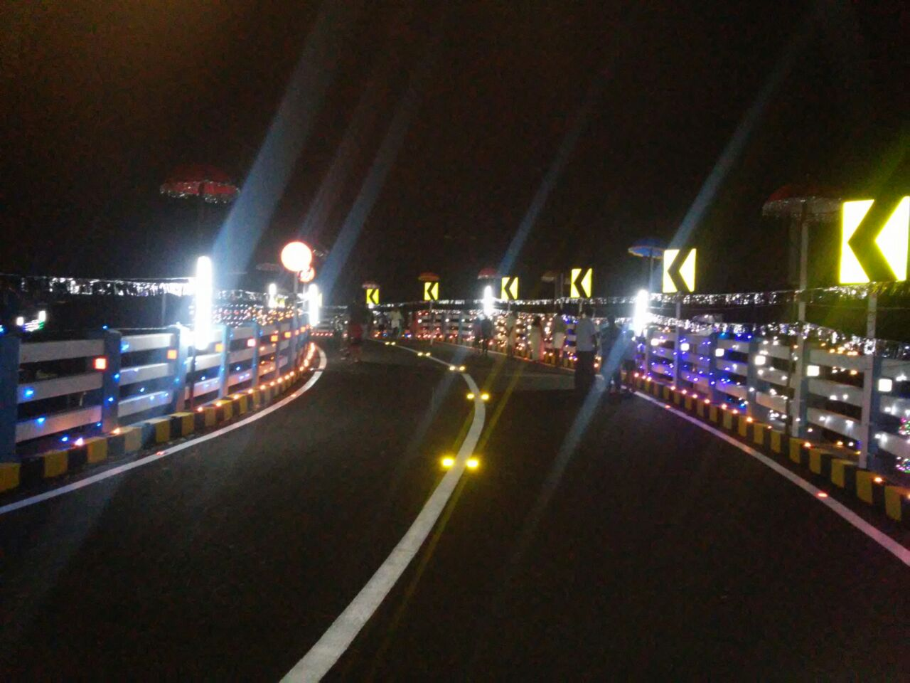
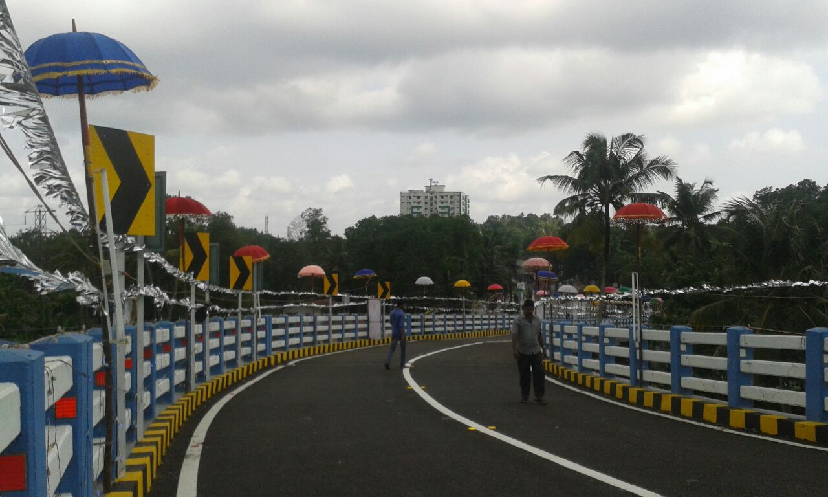
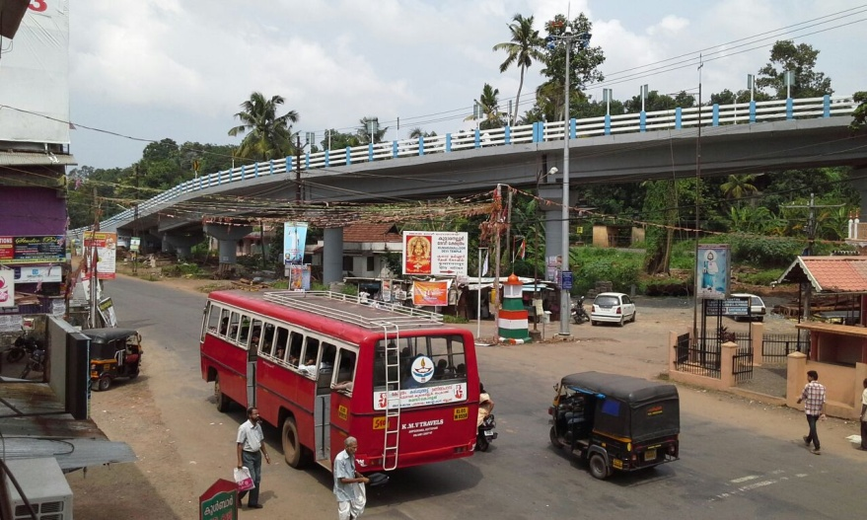
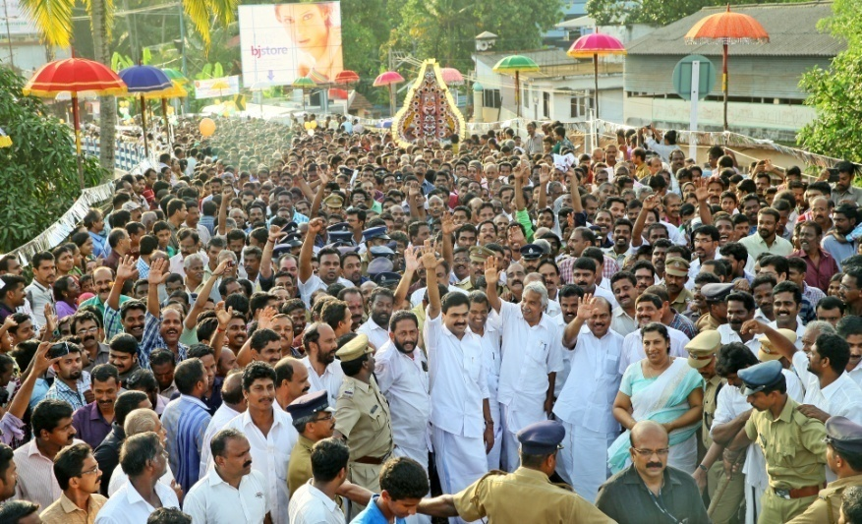
ROB AT KUMARANELLUR
PROGRESS PHOTOS – 30.05.2015
ROB at Kumaranallor was inaugurated on 24.05.15

Slide 27
ROB AT KUNHIPALLI-

Slide 28
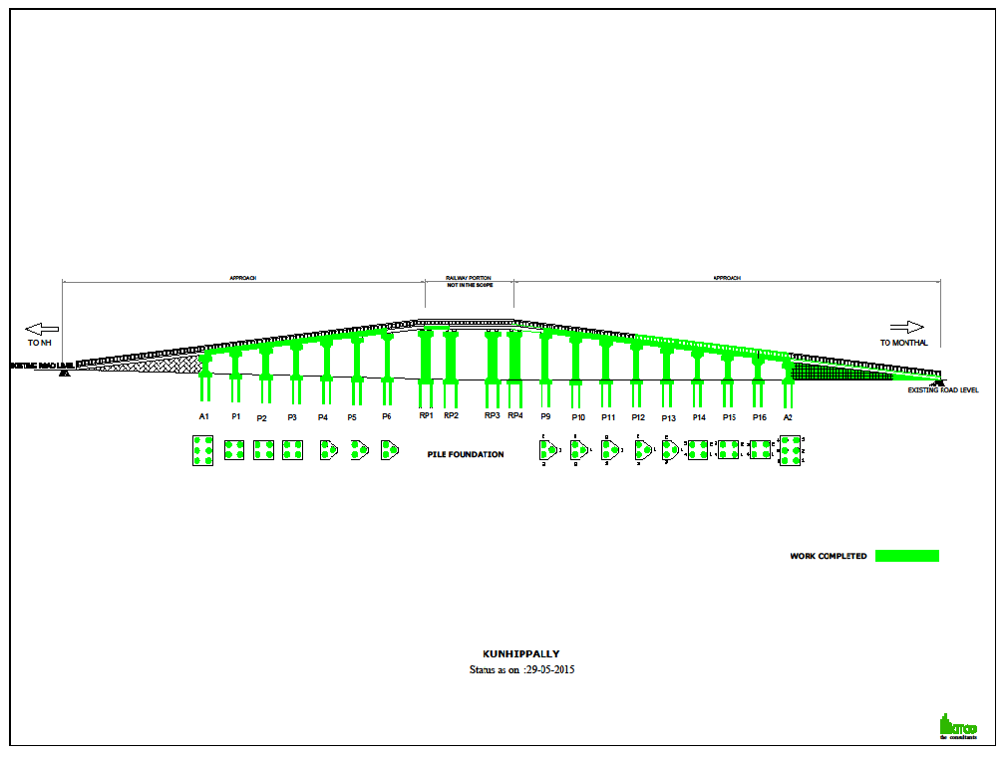
ROB AT KUNHIPALLI-
PROGRESS GRAPH 30.05.2015

Slide 29
7.ONGOING PROJECT-PROGRESS REPORT
ROB AT KUNHIPALLI- 30.05.2015
ROB AT KUNHIPALLI-
PROGRESS REPORT - 30.05.2015
Sl No | Activity Description | Total Quantity | Cumulative progress upto May 15 | Balance work up to April 15 | Cumulative delay in days from Baseline | Work planned for April 15 | Actual work done-April 15 | Delay in Qty in April 15 |  | Remarks
1 | Pile | 60 | 60 | 0
2 | Pile Load Test | 1 | 1 | 0
3 | Pilecap | 16 | 16 | 0
4 | Pier | 16 | 16 | .0
5 | Piercap | 16 | 16 | 0
6 | Girders | 16 | 14 | 2
7 | Deckslab | 16 | 14 | 2
8 | Handrails & footpath slab casting | 100% | 30% | 70%
9 | Retaining Wall NH side | 100% | 0% | 100%
10 | Retaining Wall Mondhal Bridge side | 100% | 95% | 5%
11 | Road work NH side | 100% | 0% | 100%
12 | Road work Mondhal Bridge side | 100% | 30% | 70%
13 | Drain Mondhal Bridge side | 100% | 100% | 0%
14 | Service road side | 100% | 30% | 70%
15 | Culvert Mondhal Bridge side | 100% | 100% | 0%

Slide 30
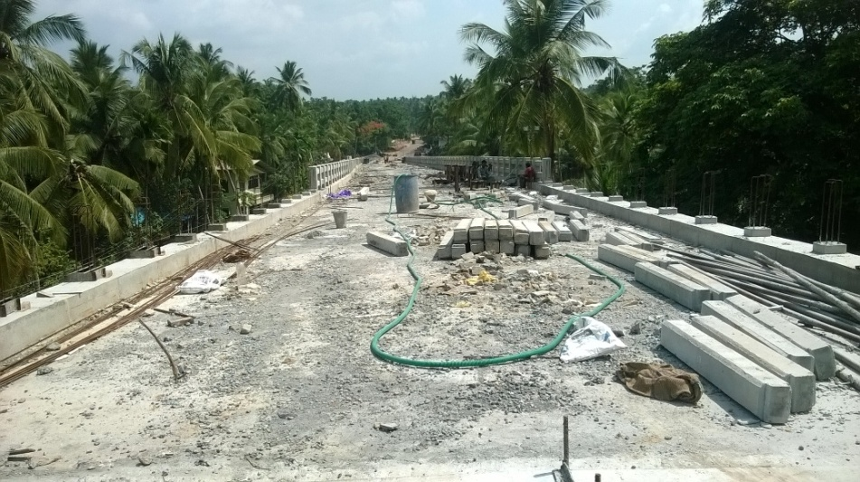
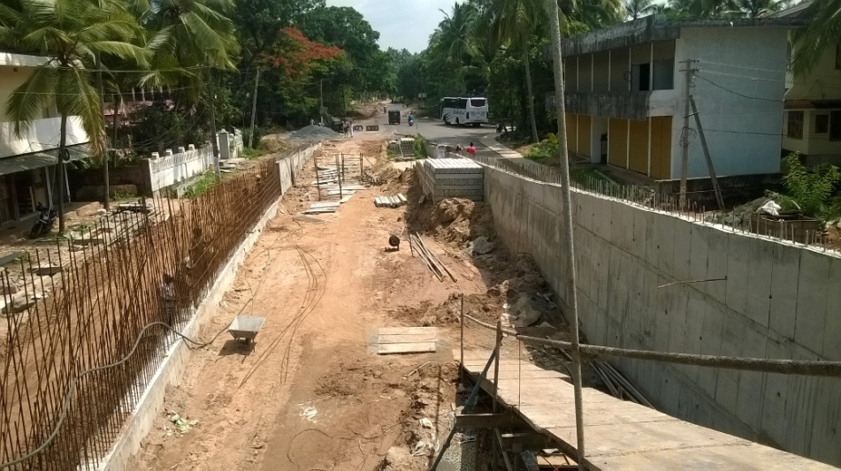
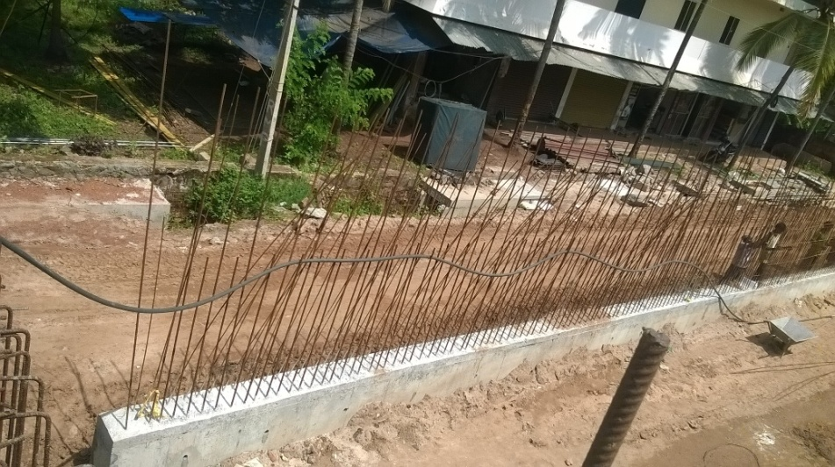
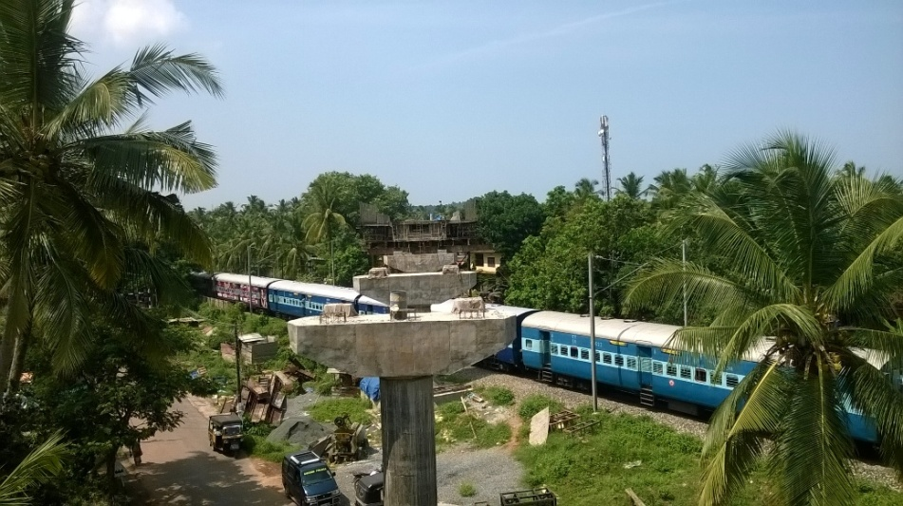
ROB AT KUNHIPALLI-
PROGRESS PHOTOS - 30.05.2015
Hand Rail work in progress P11-P12
Monthal side Service road work in progress
RCC Retaining wall works in progress
View of Railway portion

Slide 31
ROB AT EROOR

Slide 32
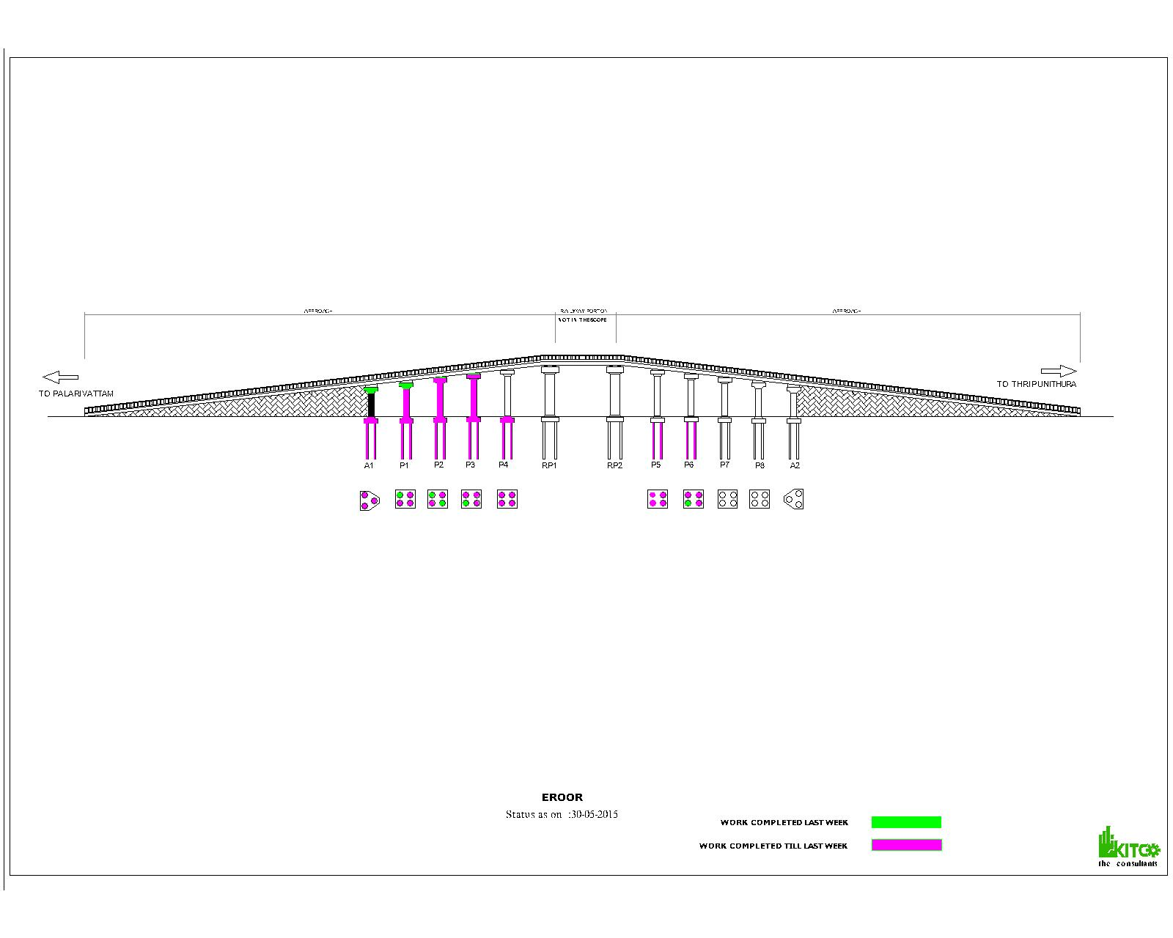
ROB AT EROOR
PROGRESS GRAPH- 30.05.2015

Slide 33
ROB AT EROOR
PROGRESS REPORT-30.05.2015
Sl No | Activity Description | Total Quantity | Cumulative progress up to May 2015 | Balance work up to May 2015 | Work planned for May 2015 | Actual work done during May 2015
1 | Pile | 38 | 31 | 7 | 8 | 12
2 | Pilecap | 10 | 5 | 5 | 1 | 1
3 | Pier | 10 | 4 | 6 | 2 | 1
4 | Piercap | 10 | 4 | 6 | 2 | 1
7 | Girders (8+2) | 10 | 0 | 10 | 0 | 0
8 | Deckslab (8+2) | 10 | 0 | 10 | 0 | 0
9 | Drainage | 40 m | 30 m |  | 100m | 30m

Slide 34
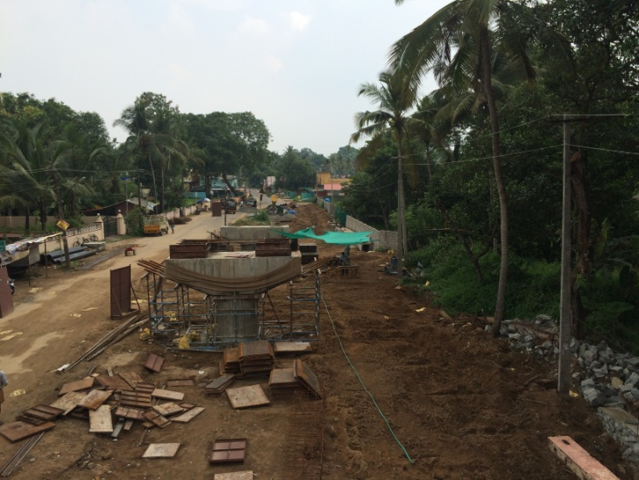
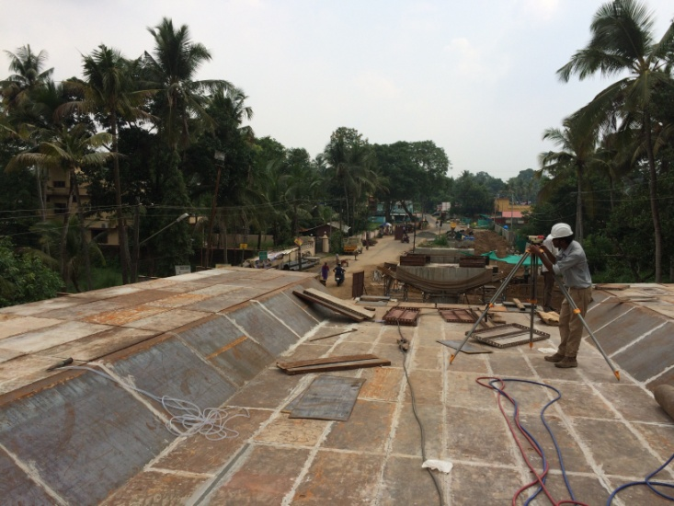
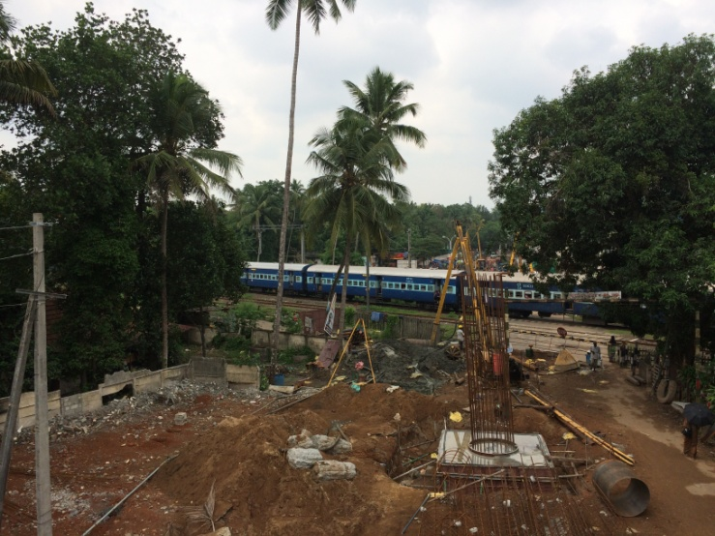
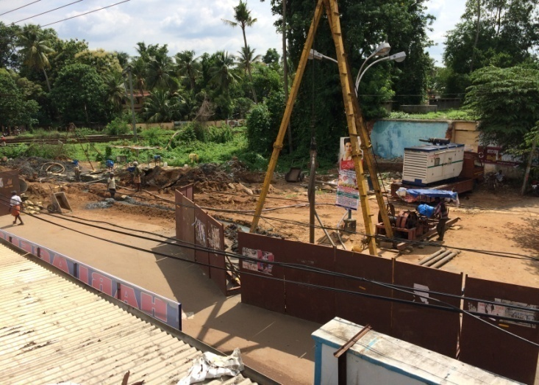
ROB AT EROOR
PROGRESS PHOTOS – 30.05.2015
P1 A1 View
Shuttering works for P2-P3 slab
P4 pier & Piling in Rail way portion
Piling in P7 location

